Slide 1
ODS API Suite
APIs to Organisation Reference Data
Danny Ruttle, Senior System Designer
Technical Connectathon – Leeds, March 2018
Notes:
@ruttledanny

Slide 2
ODS API Suite - where are we?
NHS Digital Project board established with external representation October 2017
ODS and Domain D (interoperability team)
Early version for piloting to FOT partners December 2017
Wider release of the alpha version from January 2018
Development for MVP complete 9th March 2018
Fully live service 12th April 2018
Just the beginning!
Notes:
Early – Project Board plus review group members
Dev: Internal dev team, DDC in Leeds. Agile iterative process.
Dev to Live: Service introduction processes and security checks
Beginning - This isn’t finished. Already have a phase 2 planned for 2018 and NHS Digital does want to develop the product with as much input as possible from consumers.
Likely to expand to support other areas of ODS including GPs, Consultants

Slide 3
ODS API Suite Scope
ODS Data for different customer groups
A number of ODS consumers have invested in the ODS XML format approved via SCCI and would like an API that utilises this so as to maximise their investment in using that format.
ODS ORD API
With the increasing number of FHIR based APIs there is also a need to allow ODS data to be used directly by the APIs and leverage the use of the FHIR standard.
ODS FHIR Lookup API
Notes:
ODS API suite – some confusion re: two separate APIs and the decision has been taken to provide access for the different consumers with different use cases

Slide 4
Both Interfaces Support:
Data returned as XML and JSON formats
JSON is returned by default
Search by various parameters
- limits will be applied where required
Paging for queries with large results
Versioning
Data returned is from the same database (refreshed from ODS XML products)
Notes:
Parameters: harmonised to some extend but we will be doing further work to align the interfaces where this is appropriate

Slide 5
ODS ORD API

Slide 6
Organisation Data Service - overview
Authoritative lists of organisations & practitioners
Establishment of codes for these entities
A change history record for organisations
Help, advice & query resolution on use of the data
Development of information standards in this area
Notes:
For the benefit of attendees that haven’t been closely involved with ODS data
Team of approximately 25 based in Exeter, tech, BA and back office
Service catalogue is on our website and ODS provides a number of products and services to support Health and Social Care
The majority of our products are supported by information standards

Slide 7
ODS Data Evolution and ORD
CSVs have been in place for many years – limitations
Inherited approach to coding flawed – future: ANANA
SCCI Information Standard Notice (SCCI0090) ORD
ODS XML released Feb 2017 - Monthly
Interest in APIs growing
ORD standard refers to daily releases of XML
Allow consumers to take delta changes and apply to a local data store, options…
ODS Data should be easier to consume
Notes:
CSVs
1. Fixed length records, limited numbers of relationships, varying file descriptions (approx. 70)
Inherited approach
Leading characters
Key organisations limited to 3 chars – code exhaustion forecast for some of these types
SCCI
Approved August 2016
CSVs remain in place until November 2021 by which time all consumers need to migrate to XML
SCCI - recommendation - a programme of work separate to ODS established to manage this change

Slide 8
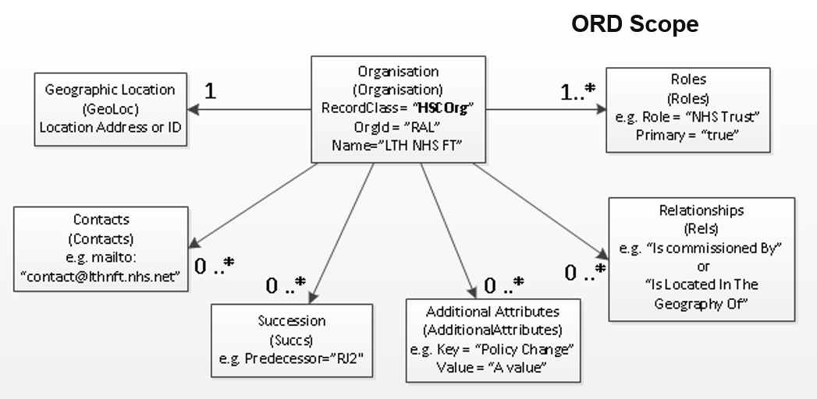
ORD High Level data Model

Slide 9
Advantages of an API to ORD
An API to access ODS data offers a significant number of advantages over the release of daily XML extracts as follows:
a simplified mechanism for updating record changes
users can connect and retrieve updates at their convenience
users can make the choice as to whether to store the data locally or access it on demand
users can baseline the data using the XML products and connect to the service to retrieve updates via the ‘LastChangeDate’ mechanism
Notes:
Simplified
Any complexity is hidden from consumers – done in the back end
Essentially the delta file will be generated from our internal OSCAR application and made available to the API
Connect
Removes the dependency on publication schedules
Choice
1. The interfaces support multiple scenarios/use cases
XML products
e.g. where a local data store is required for performance then baseline and LastChangeDate
ORD points
Local systems use the same processes and tools to handle the XML
Consumers will be investing in moving over to the XML products
ODS has made supporting tools available, primarily XSLTs to allow
Supports transactional lookups but also allows consumers to synchronise changes into a local data store

Slide 10
Proposed Adoption of ORD

Slide 11
ORD API Endpoints
/ORD/2-0-0/organisations/<ODS Code>
/ORD/2-0-0/organisations?<Search Parameters>
/ORD/2-0-0/Sync?<LastChangeDate>
#2 includes:
Query ODS Data using a single ODS Code
Query ODS Data using the organisation name
Query ODS Data using address postcode
Query ODS Data using the record status
Query ODS data using the Primary Role
Query ODS data using non-Primary Role
Query ODS data using LastChangeDate
https://......../organisations/RH8
https://......../organisations?Name=Barnsley%20District&Status=Active
https://......../sync?LastChangeDate=2017-10-25
Notes:
Split into endpoints

Slide 13
ODS FHIR Lookup API

Slide 14
Overview – FHIR Lookup API
RESTful interface
Compliant with HL7 FHIR STU3 standard
Returns a minimal ODS record
Supports search on records using a defined set of attributes

Slide 15
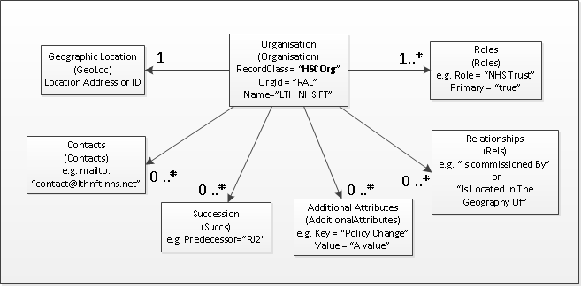
FHIR Scope

Slide 16
FHIR Lookup API
Query ODS Data using a single ODS Code
Query ODS data using the last updated date
Query ODS Data using the organisation name
Query ODS Data using the active record status
Query ODS Data using the address postcode
Query ODS Data using the address city
Query ODS data using the organisation role and primary role status

Slide 17
Implementation Guidance
Can be found at:
https://developer.nhs.uk/apis/ods/

Slide 18
Summary Slide
We expect adoption of the API Suite to be ramp up as we approach 2020 as consumers migrate away from the CSV files to XML + API and as the FHIR standards mature
Take advantage of the resources today
No such thing as a stupid question
We want to work with all consumers to make the service as good as it can be

Slide 19
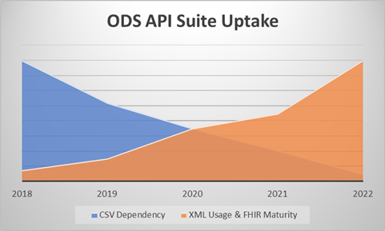

Slide 20
Questions?
https://digital.nhs.uk/organisation-data-service/APIs
ODS ORD API:
exeter.heldesk@nhs.net
https://developer.nhs.uk/library/identifiers/ods-ord-api-implementation-guide/
ODS FHIR API:
interoperabilityteam@nhs.net
https://developer.nhs.uk/apis/ods/
Notes:
@ruttledanny

Slide 21
Content

