Slide 1
Care Connect API
Overview & Roadmap
presented by Richard Kavanagh

Slide 2
Contents
The Care Connect API Journey
Current Status
Implementation Guide
Reference Implementation
Security and “SMART on FHIR”
Confirmed Future Developments
The future of Care Connect API

Slide 3
The Care Connect API Journey

Slide 4
Care Connect Development
The NHS Digital development of the Care Connect API was created as a result of a commission from NHS England.
The original request was to place an API wrapper around the Care Connect profiles being created within the INTEROPen community.
The Care Connect API project’s focus was on the API not the profiles.
The initial project scope was constrained to “point to point” API connections

Slide 5
Project Scope #1
The Care Connect API project was initiated as an agile project scoped to consider an API specification for the following clinical content
Allergies
Medications
Immunizations
Procedures
Observations
Encounters
Conditions
As per other NHS Digital FHIR implementation guides, the development was undertaken in the open with the guide being developed on GitHub - https://nhsconnect.github.io/CareConnectAPI

Slide 6
Project Scope #2
As part of the Programme 14 delivery approach, the scope was extended to not only provide an implementation guide but also to build a reference implementation.
The purpose of the reference implementation is to:
Test the implementation guide specification
Provide an open source implementation of the Care Connect API
Create a public API endpoint for interested parties to use
Create a collection of reusable test tools to assist implementers

Slide 7
Current Status – Implementation Guide

Slide 8
Implementation Guide
The Care Connect API implementation guide is not based around any one specific use case and as such it is expected that implementers will implement the parts they require to meet their local use cases.
The guide is organised along a development roadmap

Slide 9
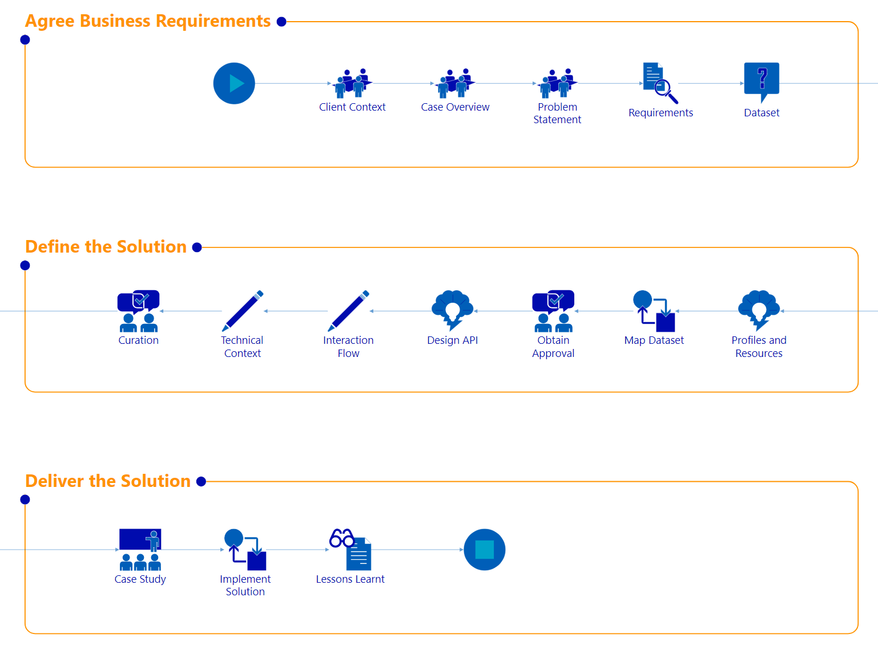
Implementation Approach
The implementation guide describes a process a provider can take for implementing the Care Connect API (including engagement with INTEROPen)

Slide 10
API Parameters
When creating a RESTful API it is necessary to define the mechanism by which the resources can be queried
We are working with INTEROPen to agree these
An example is shown below (for allergies)

Slide 11
Current Status – Reference Implementation

Slide 12
Reference Implementation
The most efficient way to implement a FHIR server was to make use of existing solutions available within the FHIR community
As our intention was to release the reference implementation as an open source project, we chose an existing open source project as a starting point.
The reference implementation makes use of the FHIR HAPI server as published at http://hapifhir.io/
The NHS Digital reference implementation is developed in the open on GitHub at:- https://github.com/nhsconnect/careconnect-reference-implementation

Slide 13
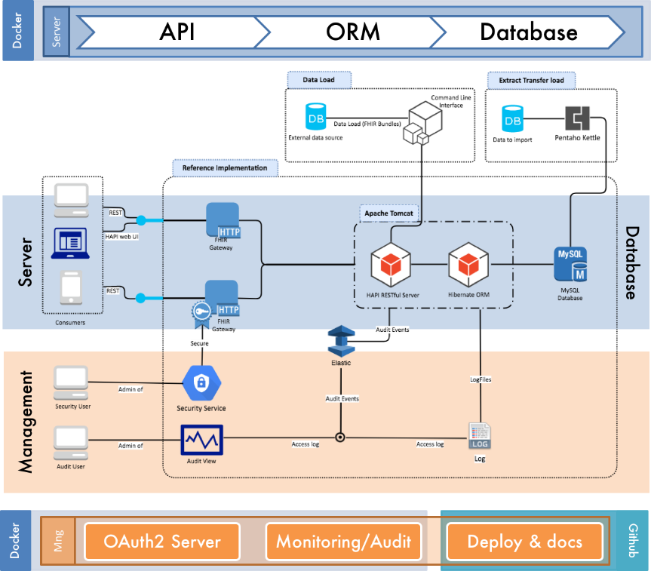
FHIR Server Design & Approach
All aspects of the design process, decisions and internal architectures of the reference implementation are documented within the implementation guide.
The documentation guides developers through an approach for building a FHIR server, it is not intended to be prescriptive but does show an approach that demonstrably works.
When creating the reference implementation it was decided to make use of container technology. This allows the solution created by NHS digital to be deployed locally on an organisations own infrastructure if desired.

Slide 14
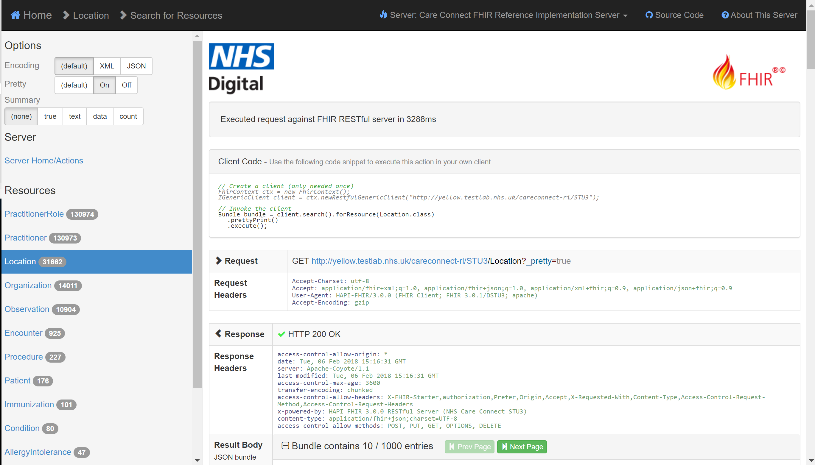
Reference Server Implementations
NHS Digital has two instances of the reference server deployed at the URLs shown below.
The test systems have been populated with synthetic test data for the purposes of testing the FHIR interface. This data is not clinically validated.
A web based test harness is also available that sits on the top of these end points available by removing the “/STU3” part of the URL.
Stable Environment
http://yellow.testlab.nhs.uk/careconnect-ri/STU3
Development Environment
http://purple.testlab.nhs.uk/careconnect-ri/STU3

Slide 15
Current Status – Security
(Including SMART on FHIR)

Slide 16
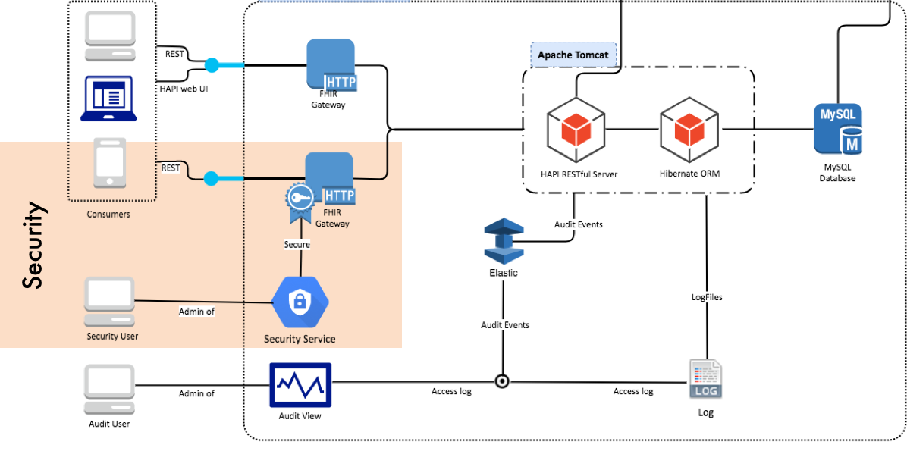
Reference Implementation
The reference servers can be accessed in both a secure and unsecure manner. To access the secure version then the URLs should start with https:// as opposed to http://
The implementation makes use of OAuth2 and security scopes as per the SMART on FHIR standard.

Slide 17
Confirmed Future Developments

Slide 18
Known Future Developments
A number of developments are currently underway on the Care Connect API. These are summarised below:
The Care Connect API and Reference Implementation will be revised so as to support the new Care Connect profiles being created via the INTEROPen curation process (expected 2018-Q1)
The Care Connect API and Reference Implementation will be revised so as to support an mechanism to retrieve care information in one operation (expected 2018-Q1)
The Care Connect API and Reference Implementation will be enhanced so as to make use of the national “Spine Security Proxy” required for national coverage. (expected 2018-Q1)

Slide 19
Care Connect API – The future
Discussions are underway to explore the future direction of the CareConnect API.
If you have thoughts on this then engage with INTEROPen to share your thoughts.
http://www.interopen.org/

